Slide 1

Large-Scale Machine Learning: SVM
Note to other teachers and users of these slides: We would be delighted if you found this our material useful in giving your own lectures. Feel free to use these slides verbatim, or to modify them to fit your own needs. If you make use of a significant portion of these slides in your own lecture, please include this message, or a link to our web site: http://www.mmds.org
Mining of Massive Datasets
Jure Leskovec, Anand Rajaraman, Jeff Ullman Stanford University
http://www.mmds.org

Slide 2
New Topic: Machine Learning!
High dim. data
Locality sensitive hashing
Clustering
Graph data
PageRank, SimRank
Community Detection
Infinite data
Filtering data streams
Web advertising
Dimensionality reduction
Spam Detection
Queries on streams
Machine learning
SVM
Decision Trees
Perceptron, kNN
Apps
Recommender systems
Association Rules
Duplicate document detection

Slide 3
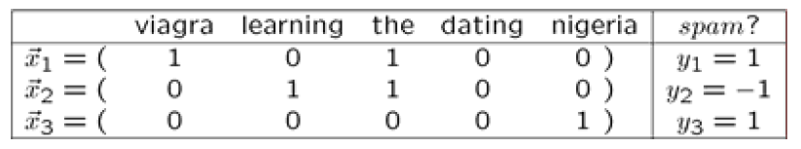
Supervised Learning
Example: Spam filtering
Instance space x ∈ X (|X|= n data points)
Binary or real-valued feature vector x of word occurrences
d features (words + other things, d~100,000)
Class y ∈ Y
y: Spam (+1), Ham (-1)
Goal: Estimate a function f(x) so that y = f(x)

Slide 4
More generally: Supervised Learning
Would like to do prediction:
estimate a function f(x) so that y = f(x)
Where y can be:
Real number: Regression
Categorical: Classification
Complex object:
Ranking of items, Parse tree, etc.
Data is labeled:
Have many pairs {(x, y)}
x … vector of binary, categorical, real valued features
y … class ({+1, -1}, or a real number)

Slide 5

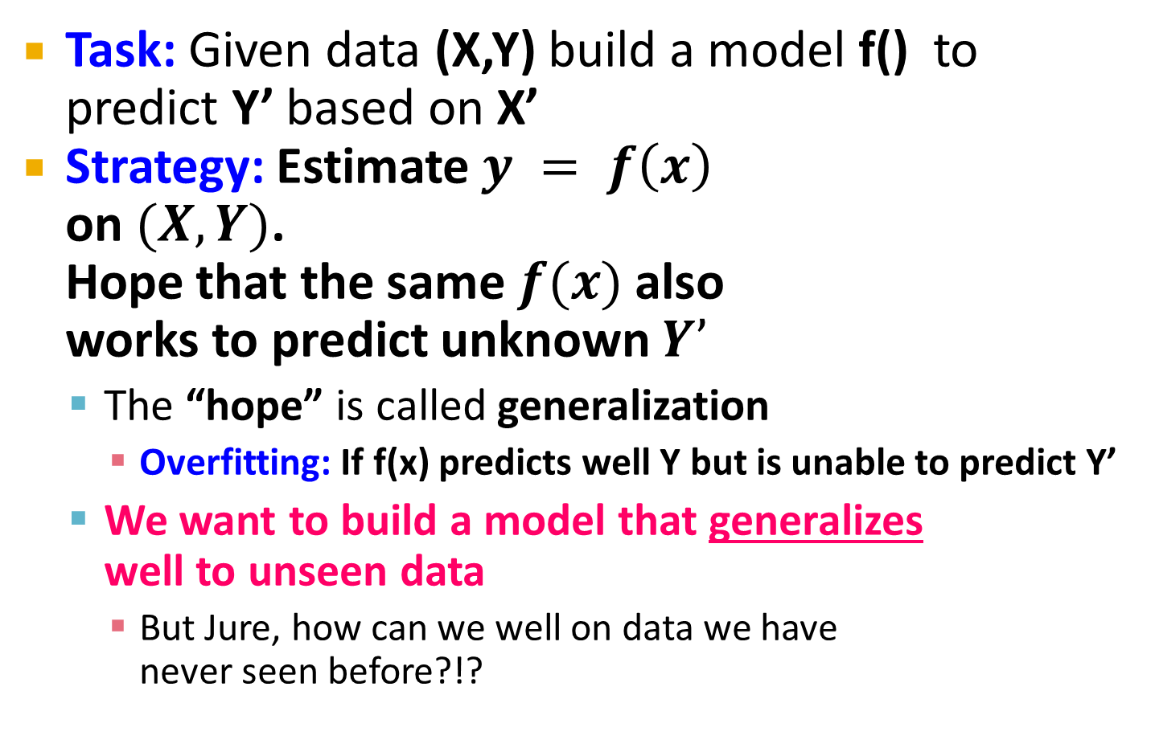
Supervised Learning
Task: Given data (X,Y) build a model f() to predict Y’ based on X’
Strategy: Estimate $y = f\left(x\right)$ on $(X,Y)$. Hope that the same $f(x)$ also works to predict unknown $Y’$
The “hope” is called generalization
Overfitting: If f(x) predicts well Y but is unable to predict Y’
We want to build a model that generalizes well to unseen data
But Jure, how can we well on data we have never seen before?!?
X
Y
Training data
Test data
X’
Y’

Slide 6
Supervised Learning
Idea: Pretend we do not know the data/labels we actually do know
Build the model f(x) on the training data See how well f(x) does on the test data
If it does well, then apply it also to X’
Refinement: Cross validation
Splitting into training/validation set is brutal
Let’s split our data (X,Y) into 10-folds (buckets)
Take out 1-fold for validation, train on remaining 9
Repeat this 10 times, report average performance
Training set
X
Y
Validation set
Test set
X’

Slide 7
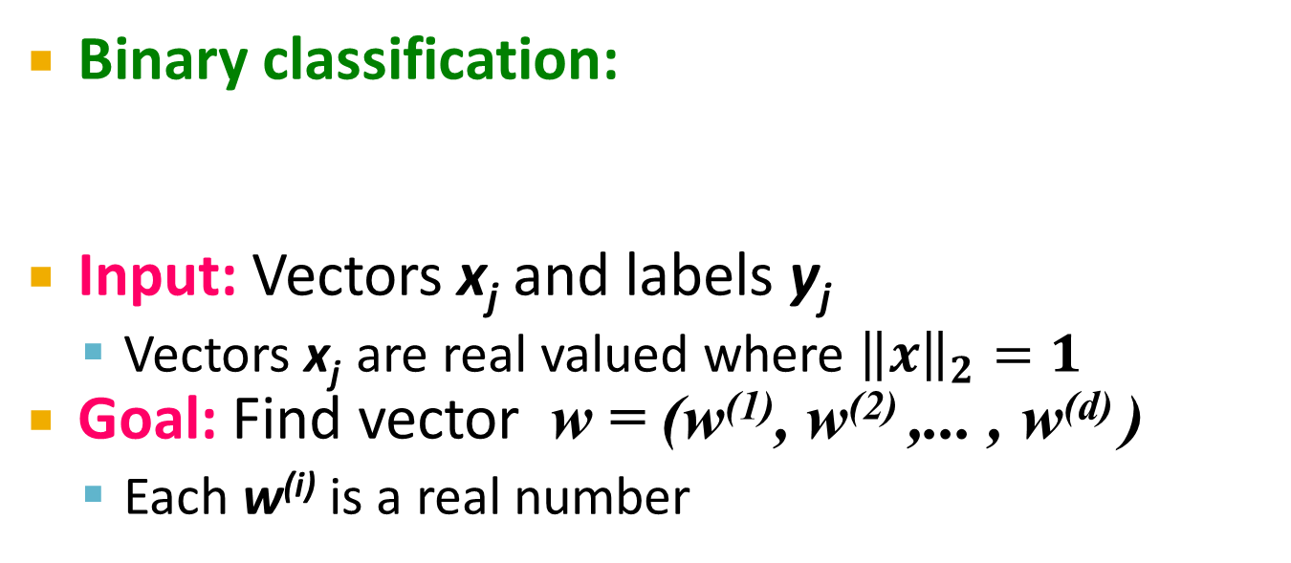
Linear models for classification
Binary classification:
Input: Vectors x_{j} and labels y_{j}
Vectors x_{j} are real valued where ${\left\|x\right\|}_{2}=1$
Goal: Find vector w = (w⁽¹⁾, w⁽²⁾ ,... , w^{(d)} )
Each w^{(i)} is a real number
{
f (x) =
+1 if w⁽¹⁾ x⁽¹⁾ + w⁽²⁾ x⁽²⁾ +. . .w^{(d)} x^{(d)} ≥ θ
-1 otherwise
Decision boundary is linear
w ⋅ x = θ
-
-
-
-
-
-
-
Note:
w ⋅ x = 0
-
-
-
-
-
w
-
-
-

Slide 8
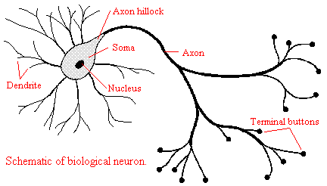
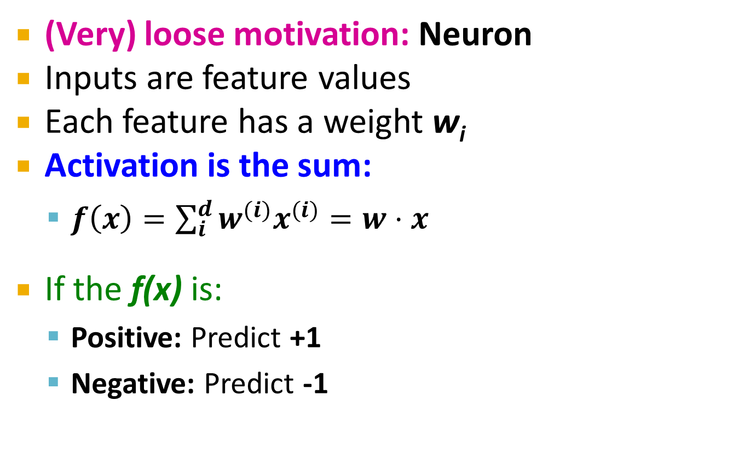
Perceptron [Rosenblatt ‘58]
(Very) loose motivation: Neuron
Inputs are feature values
Each feature has a weight w_{i}
Activation is the sum:
$f\left(x\right)=\sum_{i}^{d}{w^{(i)}x^{(i)}=w⋅x}$
If the f(x) is:
Positive: Predict +1
Negative: Predict -1
w⁽¹⁾
w⁽²⁾
w⁽³⁾
w⁽⁴⁾
x⁽¹⁾
x⁽²⁾
x⁽³⁾
x⁽⁴⁾
∑
≥ 0?
w⋅x=0
nigeria
x₁
x₂
Spam=1
w
Ham=-1
viagra

Slide 9
Perceptron
Note that the Perceptron is a conservative algorithm: it ignores samples that it classifies correctly.
Perceptron: y’ = sign(w⋅ x)
How to find parameters w?
Start with w₀ = 0
Pick training examples x_{t} one by one
Predict class of x_{t} using current w_{t}
y’ = sign(w_{t}⋅ x_{t})
If y’ is correct (i.e., y_{t} = y’)
No change: w_{t+1} = w_{t}
If y’ is wrong: Adjust w_{t}
w_{t+1} = w_{t} + η ⋅ y_{t} ⋅ x_{t}
η is the learning rate parameter
x_{t} is the t-th training example
y_{t} is true t-th class label ({+1, -1})
η⋅y_{t}⋅x_{t}
w_{t}
w_{t+1}
x_{t}, y_{t}=1

Slide 10
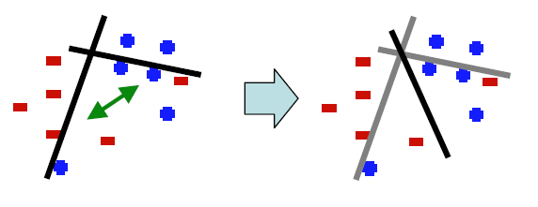
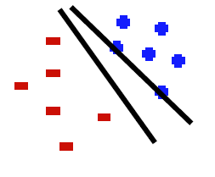
Perceptron: The Good and the Bad
Good: Perceptron convergence theorem:
If there exist a set of weights that are consistent (i.e., the data is linearly separable) the Perceptron learning algorithm will converge
Bad: Never converges: If the data is not separable weights dance around indefinitely
Bad: Mediocre generalization:
Finds a “barely” separating solution

Slide 11
Updating the Learning Rate
Perceptron will oscillate and won’t converge
So, when to stop learning?
(1) Slowly decrease the learning rate η
A classic way is to: η = c₁/(t + c₂)
But, we also need to determine constants c₁ and c₂
(2) Stop when the training error stops chaining
(3) Have a small test dataset and stop when the test set error stops decreasing
(4) Stop when we reached some maximum number of passes over the data

Slide 12
Support Vector Machines

Slide 13

Support Vector Machines
Want to separate “+” from “-” using a line
Data:
Training examples:
(x₁, y₁) … (x_{n}, y_{n})
Each example i:
x_{i} = ( x_{i}⁽¹⁾,… , x_{i}^{(d)} )
x_{i}^{(j)} is real valued
y_{i} ∈ { -1, +1 }
Inner product:
$w⋅x=\sum_{j=1}^{d}{w^{(j)}⋅x^{(j)}}$
+
+
+
-
+
+
-
+
-
-
-
-
-
Which is best linear separator (defined by w)?

Slide 14
Largest Margin
Distance from the separating hyperplane corresponds to the “confidence” of prediction
Example:
We are more sure about the class of A and B than of C
A
C
+
+
+
+
-
+
B
-
+
+
-
+
-
-
+
-
-
-
-

Slide 15
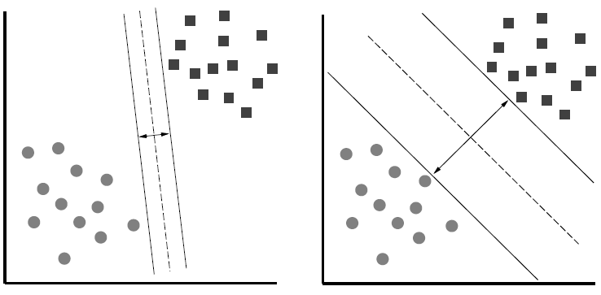
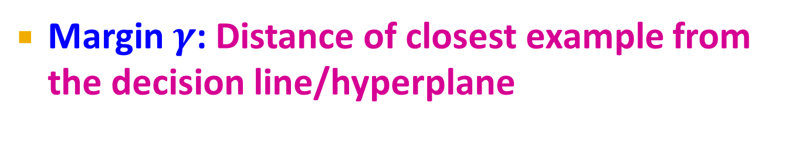
Largest Margin
Margin $γ$: Distance of closest example from the decision line/hyperplane
The reason we define margin this way is due to theoretical convenience and existence of generalization error bounds that depend on the value of margin.
Notes:
Why define margin as distance to the closest example, why not avg. or something else?
Purely theoretical

Slide 16
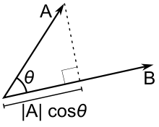



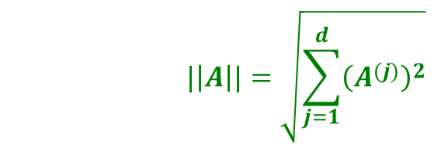
Why maximizing $γ$ a good idea?
Remember: Dot product $A⋅B=\left\|A\right\|⋅\left\|B\right\|⋅\cos{θ}$
$$\left\|A\right\|cosθ$$
$$|\left|A\right||=\sqrt{\sum_{j=1}^{d}{{\left(A^{(j)}\right)}^{2}}}$$

Slide 17

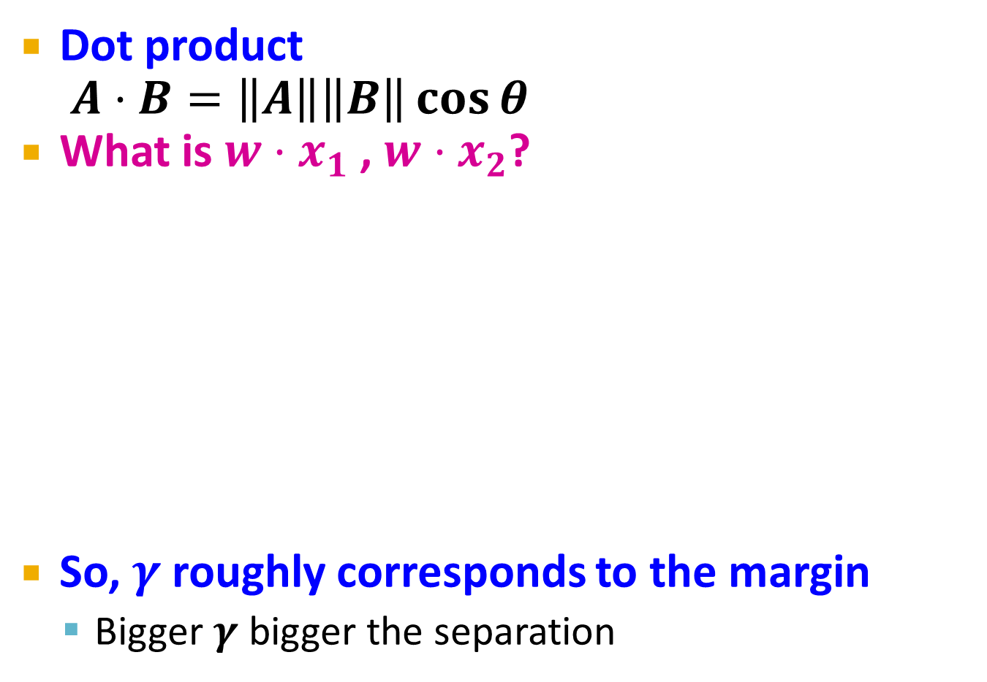


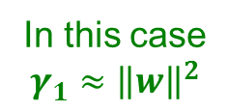

Why maximizing $γ$ a good idea?
Dot product $A⋅B=\left\|A\right\|\left\|B\right\|\cos{θ}$
What is $w⋅x_{1}$ , $w⋅x_{2}$?
So, $γ$ roughly corresponds to the margin
Bigger $γ$ bigger the separation
$$w$$
x₂
+
+
w ⋅ x + b = 0
x₁
x₂
x₂
+
+
+
+
x₁
x₁
$$w$$
$$w$$
In this case $$γ_{1}≈{\left\|w\right\|}^{2}$$
In this case
$$γ_{2}≈{2\left\|w\right\|}^{2}$$

Slide 18
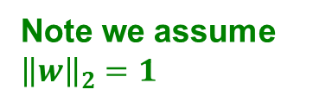
What is the margin?
Distance from a point to a line
L
Note we assume ${\left\|w\right\|}_{2}=1$
Let:
Line L: w∙x+b = w⁽¹⁾x⁽¹⁾+w⁽²⁾x⁽²⁾+b=0
w = (w⁽¹⁾, w⁽²⁾)
Point A = (x_{A}⁽¹⁾, x_{A}⁽²⁾)
Point M on a line = (x_{M}⁽¹⁾, x_{M}⁽²⁾)
w
A (x_{A}⁽¹⁾, x_{A}⁽²⁾)
w ∙ x + b = 0
+
d(A, L)
H
d(A, L) = |AH|
= |(A-M) ∙ w|
= |(x_{A}⁽¹⁾ – x_{M}⁽¹⁾) w⁽¹⁾ + (x_{A}⁽²⁾ – x_{M}⁽²⁾) w⁽²⁾|
= x_{A}⁽¹⁾ w⁽¹⁾ + x_{A}⁽²⁾ w⁽²⁾ + b
= w ∙ A + b
(0,0)
M (x₁, x₂)
Remember x_{M}⁽¹⁾w⁽¹⁾ + x_{M}⁽²⁾w⁽²⁾ = - b
since M belongs to line L

Slide 19
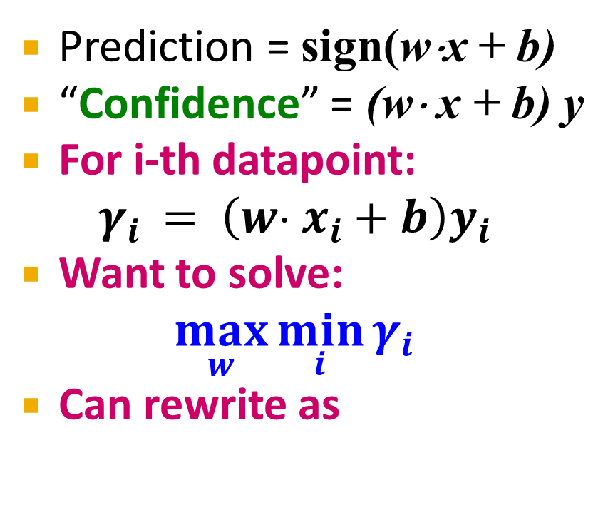

Largest Margin
Prediction = sign(w⋅x + b)
“Confidence” = (w⋅ x + b) y
For i-th datapoint: $γ_{i} = \left(w⋅ x_{i}+b\right)y_{i}$
Want to solve:
$$\max_{w}{\min_{i}{γ_{i}}}$$
Can rewrite as
$$w$$
+
+
+
+
w ⋅ x + b = 0
-
+
-
+
+
-
-
-
-
-

Slide 20

Support Vector Machine
Maximize the margin:
Good according to intuition, theory (VC dimension) & practice
$γ$ is margin … distance from the separating hyperplane
+
+
w⋅x+b=0
+
+
+
-
+
γ
+
γ
-
-
-
+
γ
-
-
-
Maximizing the margin

Slide 21
Support Vector Machines: Deriving the margin

Slide 22
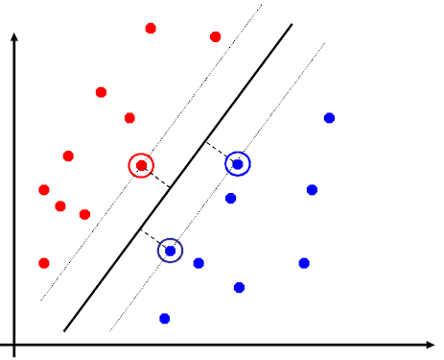
Support Vector Machines
Separating hyperplane is defined by the support vectors
Points on +/- planes from the solution
If you knew these points, you could ignore the rest
Generally, d+1 support vectors (for d dim. data)

Slide 23
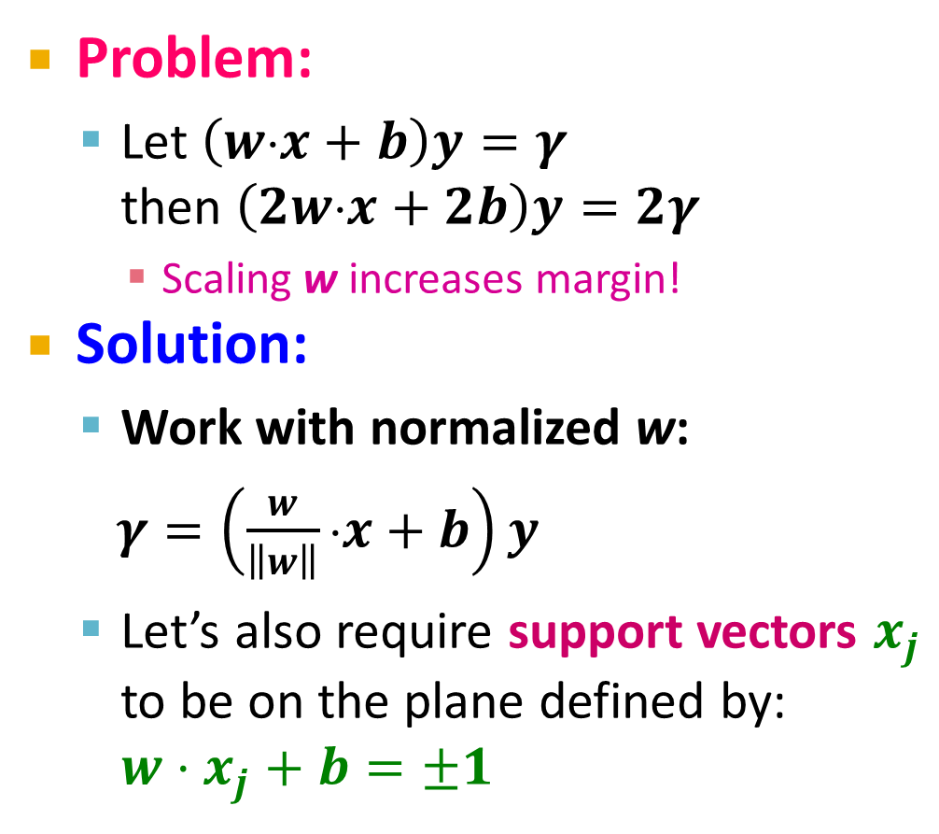
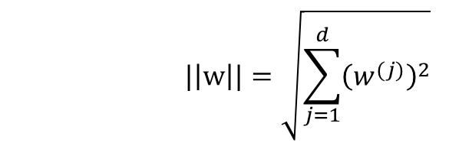
Canonical Hyperplane: Problem
Problem:
Let $\left(w⋅x+b\right)y=γ$ then $\left(2w⋅x+2b\right)y=2γ$
Scaling w increases margin!
Solution:
Work with normalized w:
$γ=\left(\frac{w}{\left\|w\right\|}⋅x+b\right)y$
Let’s also require support vectors $x_{j}$ to be on the plane defined by: $w⋅x_{j}+b=±1$
w⋅x+b=-1
w⋅x+b=0
w⋅x+b=+1
$$|\left|w\right||=\sqrt{\sum_{j=1}^{d}{{\left(w^{(j)}\right)}^{2}}}$$

Slide 24

Canonical Hyperplane: Solution
Want to maximize margin $γ$!
What is the relation between x₁ and x₂?
$x_{1}=x_{2}+2γ\frac{w}{||w||}$
We also know:
$w⋅x_{1}+b=+1$
$w⋅x_{2}+b=−1$
So:
$w⋅x_{1}+b=+1$
$w\left(x_{2}+2γ\frac{w}{||w||}\right)+b=+1$
$w⋅x_{2}+b+2γ\frac{w⋅w}{\left|\left|w\right|\right|}=+1$
w⋅x+b=-1
w⋅x+b=0
w⋅x+b=+1
2γ
Note:
-1

Slide 25
Maximizing the Margin
We started with
But w can be arbitrarily large!
We normalized and...
Then:
w⋅x+b=-1
w⋅x+b=0
w⋅x+b=+1
2γ
This is called SVM with “hard” constraints

Slide 26
Non-linearly Separable Data
If data is not separable introduce penalty:
Minimize ǁwǁ² plus the number of training mistakes
Set C using cross validation
How to penalize mistakes?
All mistakes are not equally bad!
+
+
w⋅x+b=0
+
-
+
+
-
+
-
-
+
-
+
-
-
-
-

Slide 27
Support Vector Machines
Introduce slack variables ξ_{i}
If point x_{i} is on the wrong side of the margin then get penalty ξ_{i}
+
w⋅x+b=0
+
+
-
+
ξ_{i}
+
+
ξ_{j}
-
-
+
+
-
-
-
For each data point:
If margin ≥ 1, don’t care
If margin < 1, pay linear penalty
Notes:
ksi

Slide 28
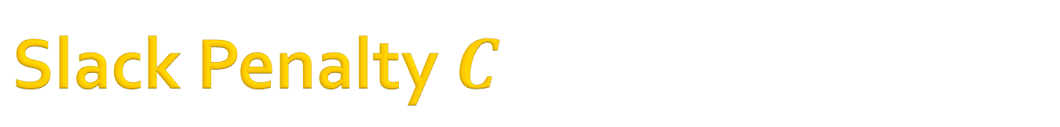
Slack Penalty $C$
What is the role of slack penalty C:
C=∞: Only want to w, b that separate the data
C=0: Can set ξ_{i} to anything, then w=0 (basically ignores the data)
small C
+
“good” C
+
+
+
+
big C
+
-
-
+
+
-
-
-
-
(0,0)

Slide 29
Support Vector Machines
SVM in the “natural” form
SVM uses “Hinge Loss”:
Margin
Empirical loss L (how well we fit training data)
Regularization parameter
penalty
0/1 loss
Hinge loss: max{0, 1-z}
-1 0 1 2

Slide 30
Support Vector Machines: How to compute the margin?

Slide 31
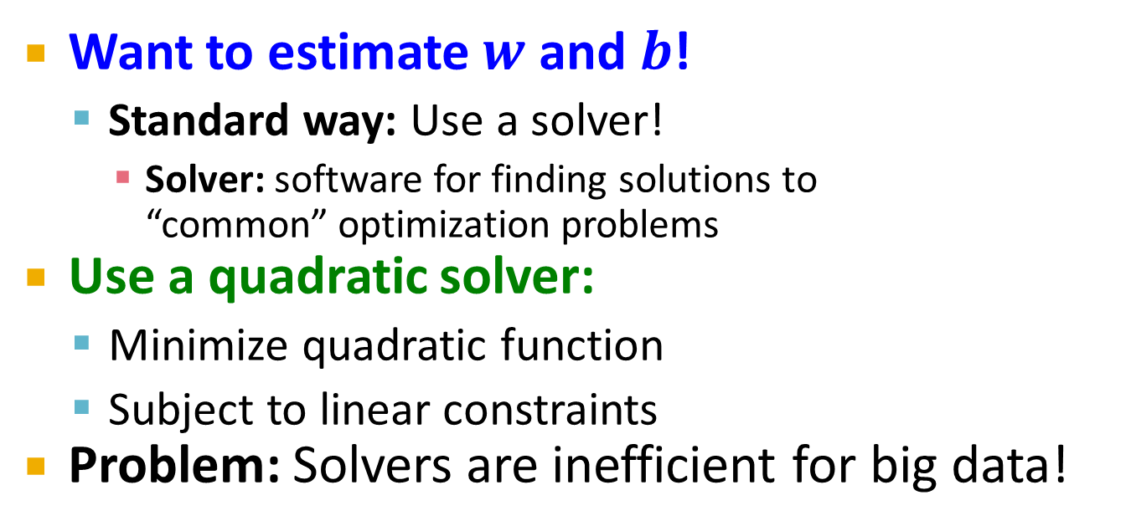
SVM: How to estimate w?
Want to estimate $w$ and $b$!
Standard way: Use a solver!
Solver: software for finding solutions to “common” optimization problems
Use a quadratic solver:
Minimize quadratic function
Subject to linear constraints
Problem: Solvers are inefficient for big data!

Slide 32
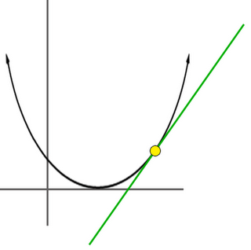

SVM: How to estimate w?
Want to estimate w, b!
Alternative approach:
Want to minimize f(w,b):
Side note:
How to minimize convex functions $g(z)$?
Use gradient descent: min_{z} g(z)
Iterate: z_{t+1} ← z_{t} – η ∇g(z_{t})
g(z)
z

Slide 33

SVM: How to estimate w?
Want to minimize f(w,b):
Compute the gradient ∇(j) w.r.t. w^{(j)}
Empirical loss $L(x_{i} y_{i})$

Slide 34
SVM: How to estimate w?
Gradient descent:
Problem:
Computing ∇f^{(j)} takes O(n) time!
n … size of the training dataset
Iterate until convergence:
For j = 1 … d
Evaluate:
Update: w^{(j)} ← w^{(j)} - η∇f^{(j)}
η…learning rate parameter C… regularization parameter

Slide 35
SVM: How to estimate w?
We just had:
Stochastic Gradient Descent
Instead of evaluating gradient over all examples evaluate it for each individual training example
Stochastic gradient descent:
Notice: no summation over i anymore
Iterate until convergence:
For i = 1 … n
For j = 1 … d
Compute: ∇f^{(j)}(x_{i})
Update: w^{(j)} ← w^{(j)} - η ∇f^{(j)}(x_{i})

Slide 36
Support Vector Machines: Example

Slide 37
Example: Text categorization
Example by Leon Bottou:
Reuters RCV1 document corpus
Predict a category of a document
One vs. the rest classification
n = 781,000 training examples (documents)
23,000 test examples
d = 50,000 features
One feature per word
Remove stop-words
Remove low frequency words

Slide 38
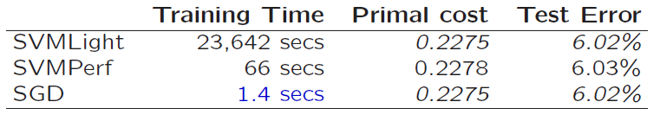
Example: Text categorization
Questions:
(1) Is SGD successful at minimizing f(w,b)?
(2) How quickly does SGD find the min of f(w,b)?
(3) What is the error on a test set?
Training time Value of f(w,b) Test error
Standard SVM “Fast SVM”
SGD SVM
(1) SGD-SVM is successful at minimizing the value of f(w,b)
(2) SGD-SVM is super fast
(3) SGD-SVM test set error is comparable

Slide 39
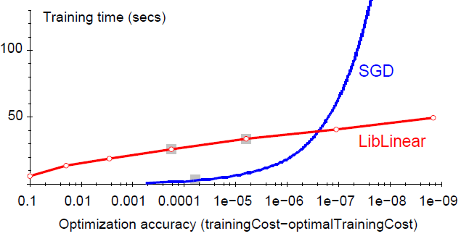
Optimization “Accuracy”
SGD SVM
Conventional SVM
Optimization quality: | f(w,b) – f (w^{opt},b^{opt}) |
For optimizing f(w,b) within reasonable quality SGD-SVM is super fast

Slide 40
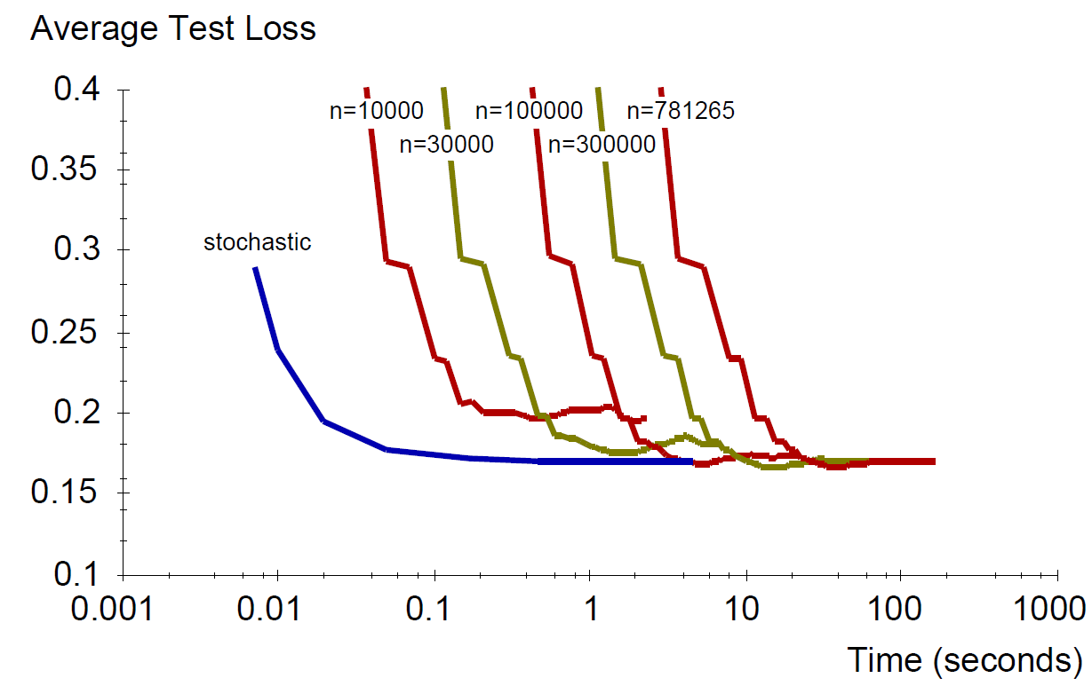
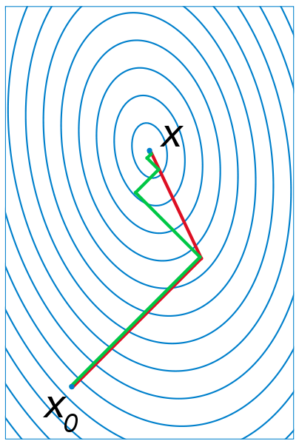
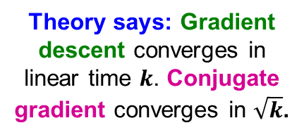

SGD vs. Batch Conjugate Gradient
SGD on full dataset vs. Conjugate Gradient on a sample of n training examples
Theory says: Gradient descent converges in linear time $k$. Conjugate gradient converges in $\sqrt{k}$.
Bottom line: Doing a simple (but fast) SGD update many times is better than doing a complicated (but slow) CG update a few times
$k$… condition number

Slide 41
Practical Considerations
Need to choose learning rate η and t₀
Leon suggests:
Choose t₀ so that the expected initial updates are comparable with the expected size of the weights
Choose η:
Select a small subsample
Try various rates η (e.g., 10, 1, 0.1, 0.01, …)
Pick the one that most reduces the cost
Use η for next 100k iterations on the full dataset

Slide 42
Practical Considerations
Sparse Linear SVM:
Feature vector x_{i} is sparse (contains many zeros)
Do not do: x_{i} = [0,0,0,1,0,0,0,0,5,0,0,0,0,0,0,…]
But represent x_{i} as a sparse vector x_{i}=[(4,1), (9,5), …]
Can we do the SGD update more efficiently?
Approximated in 2 steps:
cheap: x_{i} is sparse and so few coordinates j of w will be updated
expensive: w is not sparse, all coordinates need to be updated
Notes:
The two-step update is not equivalent!
Why does it work?
Since eta is close to 0 you can do this. You get one more eta^2 term that is low order

Slide 43
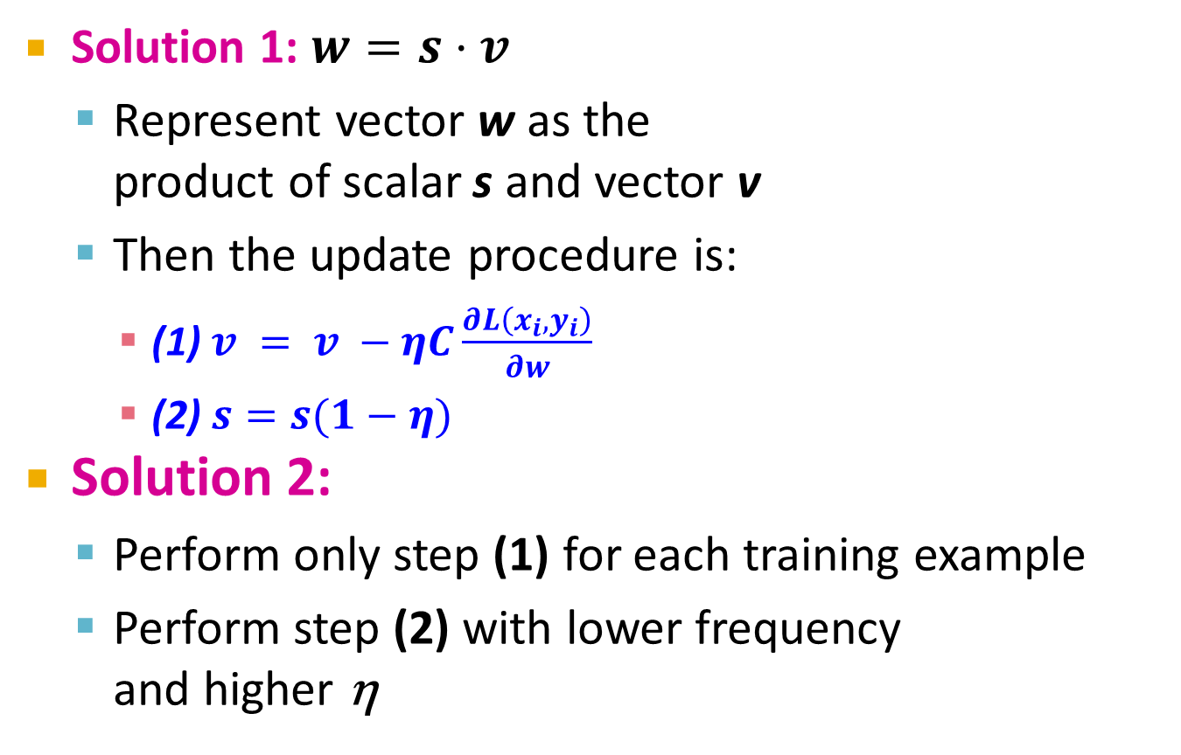
Practical Considerations
Solution 1: $w=s⋅v$
Represent vector w as the product of scalar s and vector v
Then the update procedure is:
(1) $v = v −ηC\frac{∂L\left(x_{i},y_{i}\right)}{∂w}$
(2) $s=s(1−η)$
Solution 2:
Perform only step (1) for each training example
Perform step (2) with lower frequency and higher η
Two step update procedure:
(1)
(2)

Slide 44
Practical Considerations
Stopping criteria:
How many iterations of SGD?
Early stopping with cross validation
Create a validation set
Monitor cost function on the validation set
Stop when loss stops decreasing
Early stopping
Extract two disjoint subsamples A and B of training data
Train on A, stop by validating on B
Number of epochs is an estimate of k
Train for k epochs on the full dataset

Slide 45
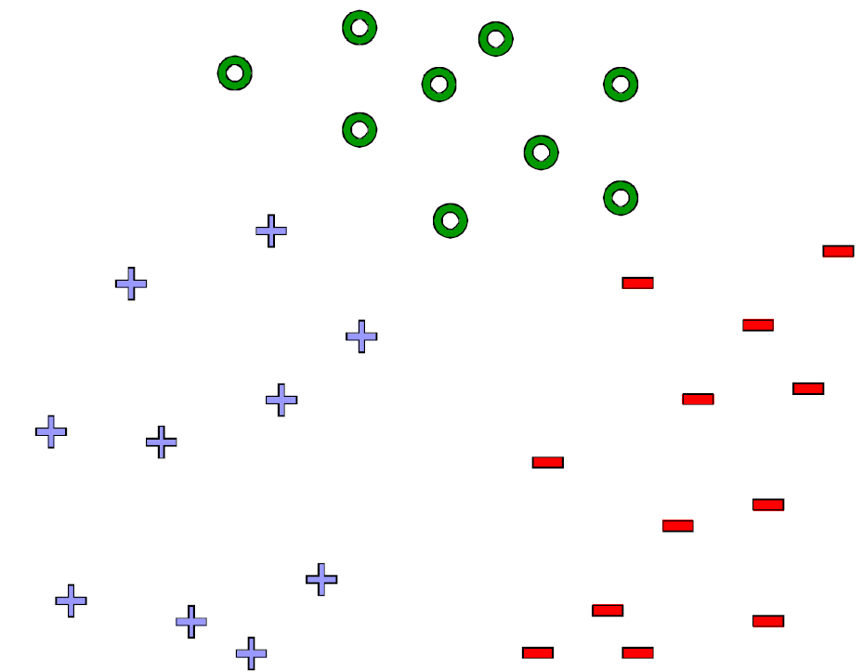
What about multiple classes?
Idea 1: One against all Learn 3 classifiers
+ vs. {o, -}
- vs. {o, +}
o vs. {+, -}
Obtain:
w₊ b₊, w₋ b₋, w_{o} b_{o}
How to classify?
Return class c arg max_{c} w_{c} x + b_{c}

Slide 46
Learn 1 classifier: Multiclass SVM
Idea 2: Learn 3 sets of weights simoultaneously!
For each class c estimate w_{c}, b_{c}
Want the correct class to have highest margin:
w_{yi} x_{i} + b_{yi} ≥ 1 + w_{c} x_{i} + b_{c} ∀c ≠ y_{i} , ∀i
(x_{i}, y_{i})

Slide 47
Multiclass SVM
Optimization problem:
To obtain parameters w_{c} , b_{c} (for each class c) we can use similar techniques as for 2 class SVM
SVM is widely perceived a very powerful learning algorithm

